Slide 1

Problem Statement
Analyze customer behavior and transaction patterns of credit card users to identify key revenue drivers, understand customer demographics and spending habits, and optimize credit card offerings and customer engagement strategies

Slide 2
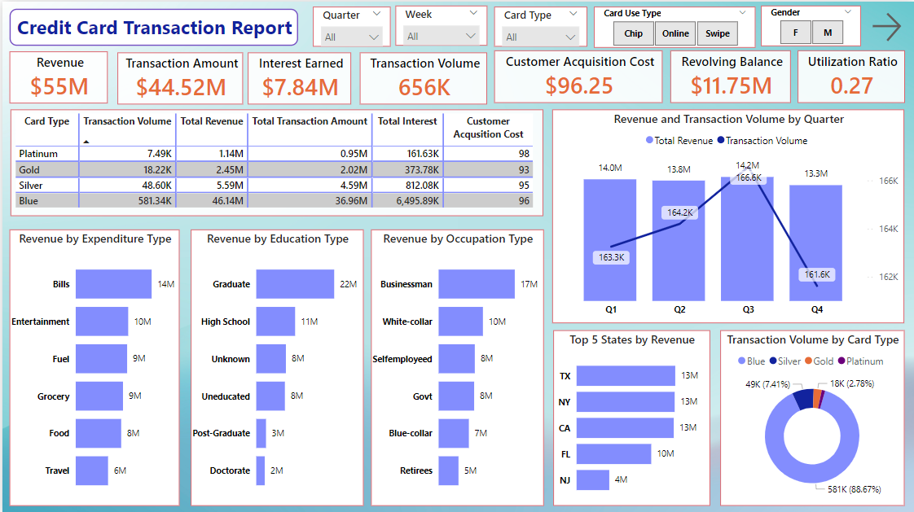

Slide 3
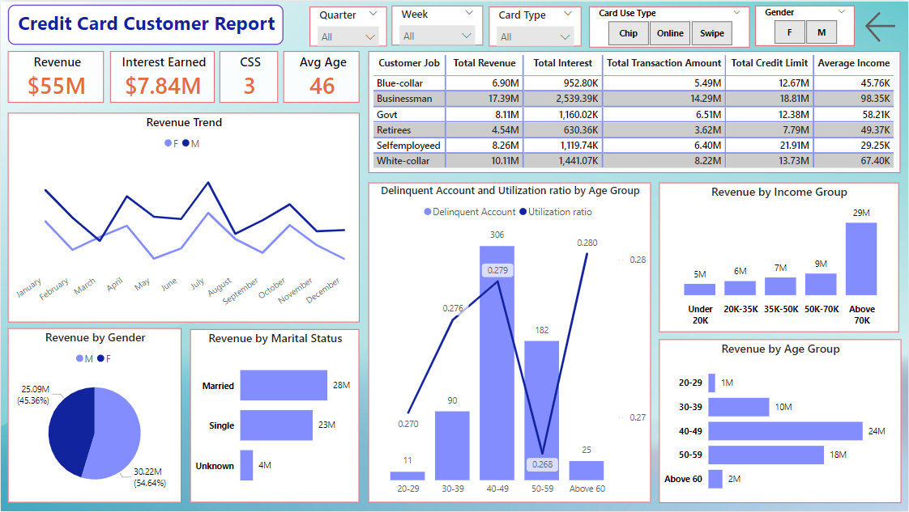

Slide 4
Insights:
Bill payments and entertainment sources contribute most to the revenue.
Graduate customers and Businessmen and white-collar professionals are significant revenue drivers. However, self- employed and Govt. workers also show a strong contribution to the revenue.
Revenue and transaction volumes are highest in the 3rd quarter although the revenue distribution across the quarters is almost even. Quarter 4 accounts for lowest transactions.
Blue cards are the most utilized cards.
Texas, New York and California are the top contributors of revenue.

Slide 5
Insights:
Males contribute slightly more revenue (54.64%) compared to females.
Married customers contribute the most revenue ($28M), followed by single customers ($23M).
The 40–49 age group is the largest contributor to revenue, followed by the 50–59 group.
Customers earning above $70K dominate revenue contributions.
The 40–49 age group has the highest delinquent accounts and utilization ratio (0.279). Customers above 60 also show rising utilization ratios indicating over reliance on credit.

